Slide 1
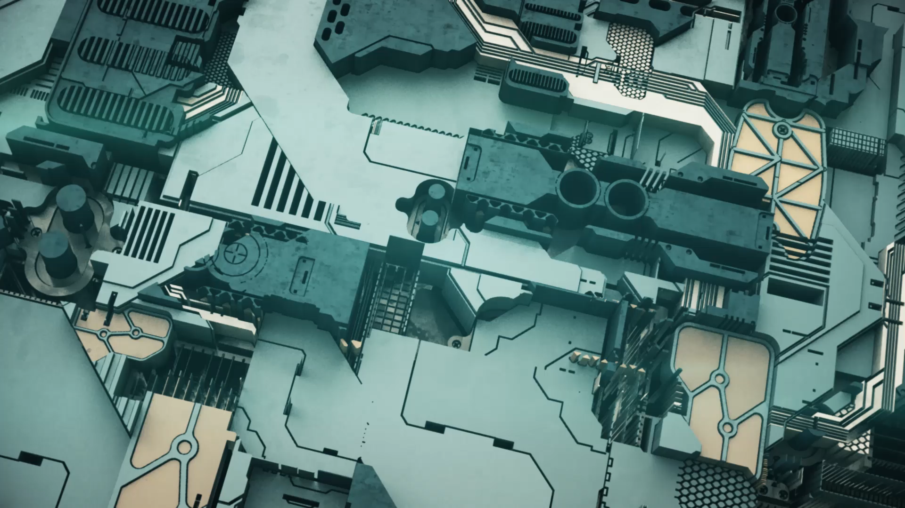
Proposal Presentation Smart Robot
Smart Mobility Engineering Lab
Mehdi Pirahandeh

Slide 2

Team members (Group – C)
Sudip Dhungana – 12194823
Sanjib Tamang – 12194939
Ritik Deuja – 12194824
Keshav Adhakari - 12194874
Pradip Thapa- 12194940
Bijay pariyar- 12194945
Yusupov Elbek - 12194909

Slide 3
Team roles and responsibilities
Members | Roles and responsibilities
Sanjib Tamang | Idea creation
Sudip Dhungana | Ppt management
Ritik Deuja | Environment setup
Keshav Adhikari | Data collection
Pradip Thapa | Team management
Bijay Pariyar | Main presenter
Yusupov Elbek | Team Participation

Slide 4
Content
Introduction
Objective
Methodology
Approach to the Project

Slide 5
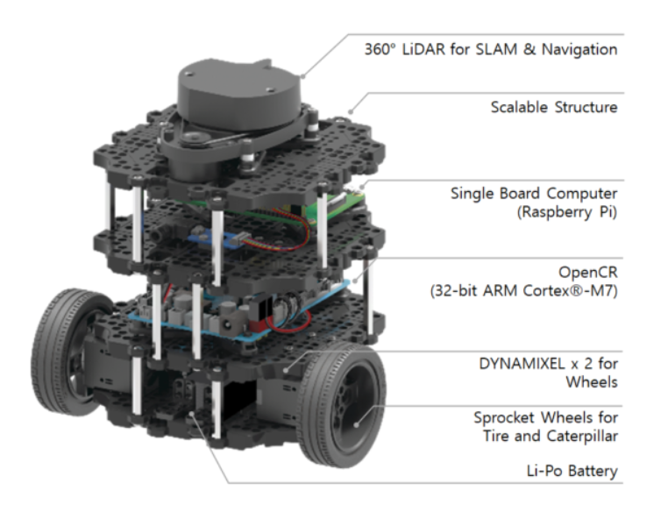
Introduction
A modern mobile robot that is modular, portable, and adaptable is the TurtleBot3 Burger.
Major Sensors and Actuators used are shown aside in the image.

Slide 6
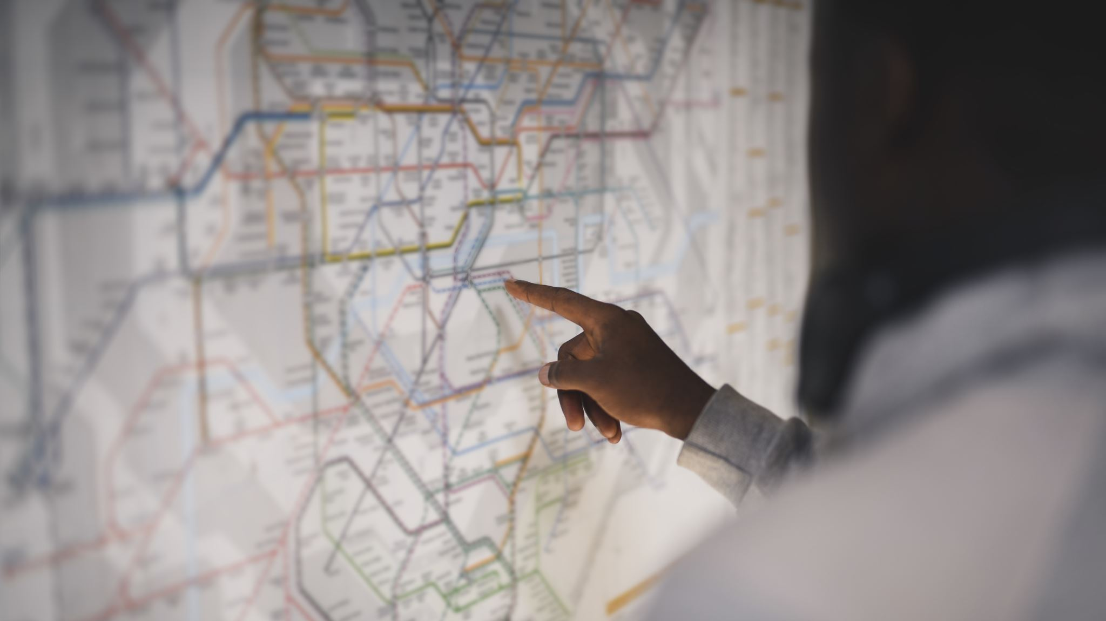
Approach to the project

Slide 7

Main Topic Covered
Traffic Sign Detection and Obstacle Detection
Included are the following ROS command-line tools.
roscore
rosrun
Roslaunch
2. It makes use of plugins like rqt.

Slide 8
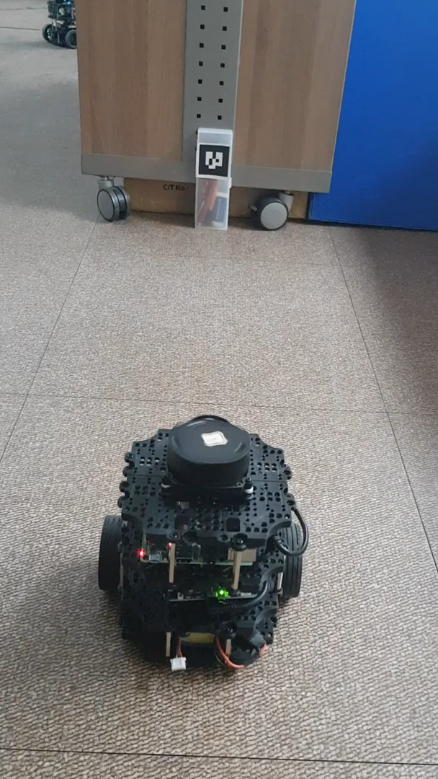
Project Objective / Proposal
The major goal of our project is to enable the Turtlebot3 to operate in autonomous driving mode that includes obstacle recognition, and traffic sign detection using Noetic Version of ROS.

Slide 9
Methodology
Installation of PC, SBC and OpenCR Setup of Turtlebot3
Run Nodes
Execute simulation
Camera sensor installation

Slide 10
Weekly activity
Week | Task | Location
1 | Team meeting and fixing idea | Star café
2 | Final proposal | Keshav room

Slide 11
Future Contributions
Members | Roles and responsibilities
Sanjib Tamang | Operating (Coding) and team tasks management ( To- keep everyone on the same page)
Sudip Dhungana | Publisher and Subscriber (Coding) for both tasks
Ritik Deuja | Operating Action (Coding)
Keshav Adhikari | Weekly Github Update
Pradip Thapa | Obstacle Detection (Client)
Bijay Pariyar | Powerpoint Management and Traffic Detection (Coding)
Yusupov Elbek | Presenter

Slide 12
THANK YOU

